Slide 1
BIM & Reality Capture in Construction
Chris Baze
BIM Manager
Hawaiian Dredging Construction Company

Slide 2
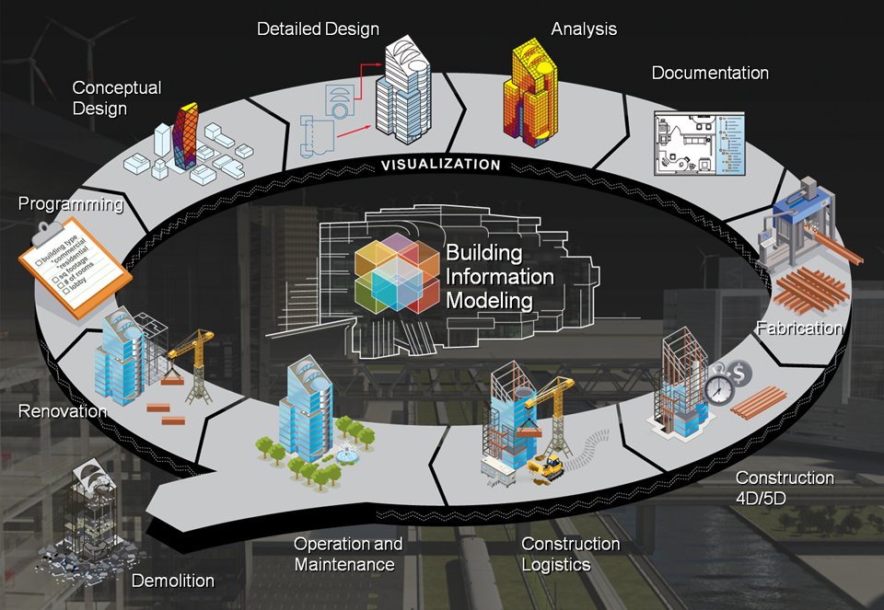
What is BIM?

Slide 3

Single Source of Truth

Slide 4
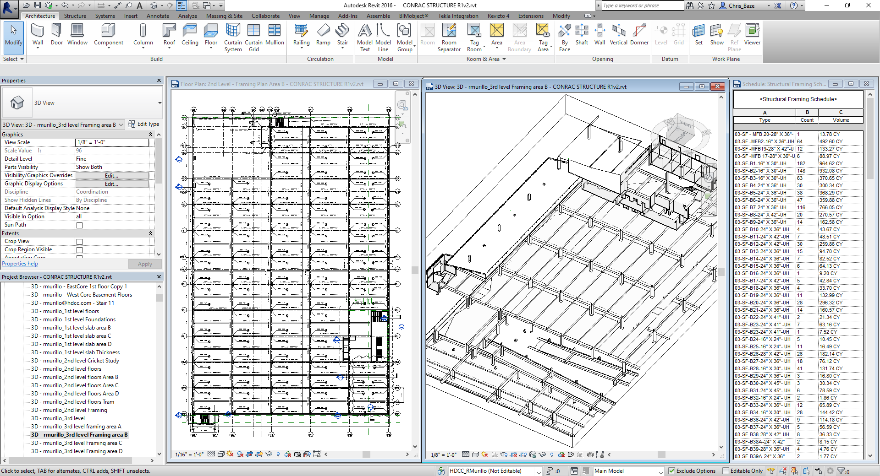

Slide 5
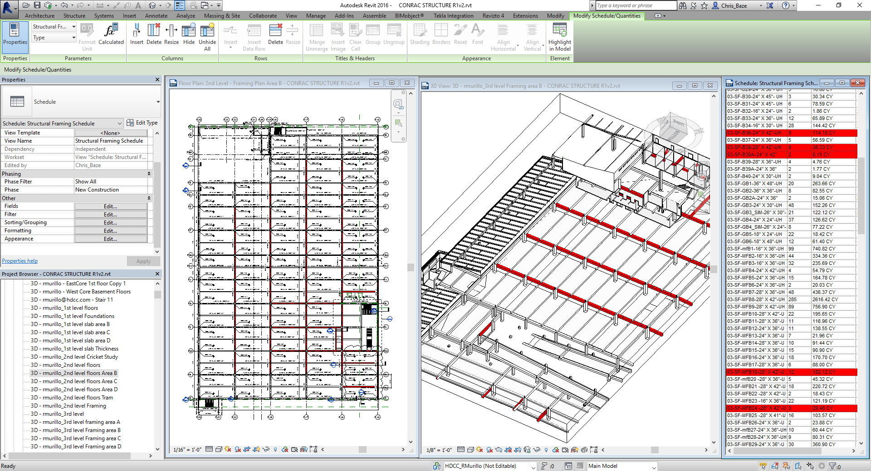

Slide 6
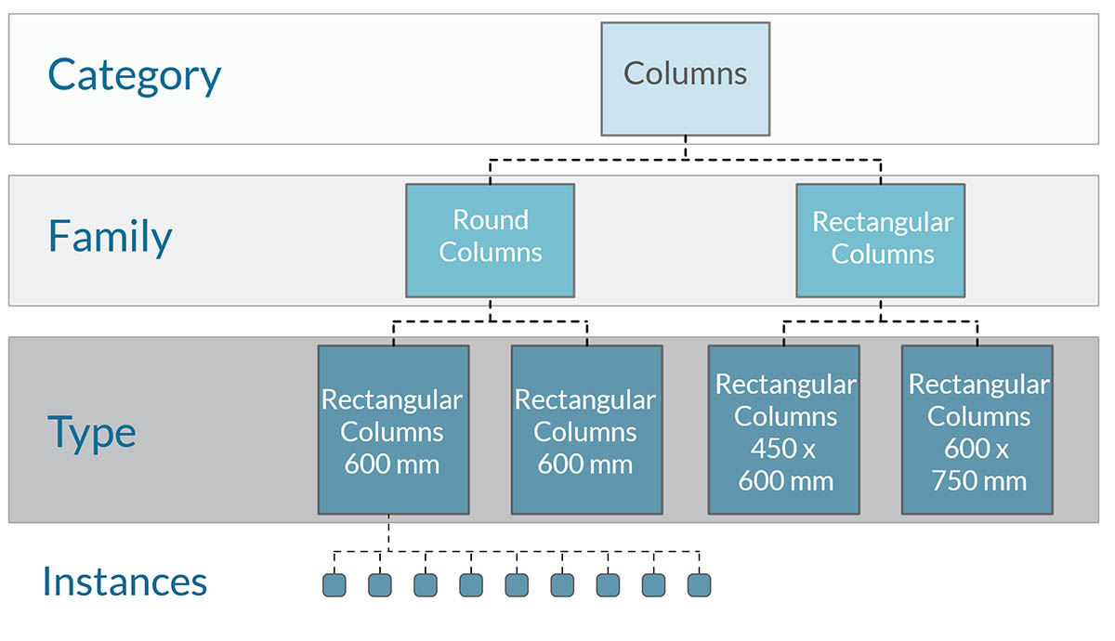
Revit Model Organization

Slide 7
Revit Family Categories
Casework
Ceilings
Conduits
Curtain Systems
Doors
Ducts
Electrical Equipment
Electrical Fixtures
Fire Alarm Devices
Floors
Furniture
Lighting Fixtures
Parking
Pipe Fittings
Pipes
Plumbing Fixtures
Railings
Ramps
Roads
Roofs
Site
Specialty Equipment
Sprinklers
Stairs
Structural Columns
Structural Foundations
Structural Framing
Structural Trusses
Walls
Windows

Slide 8
Revit Classification Manager
MasterFormat classification is used to organize project documentation and cost information. It also relates drawing notation to specifications.
UniFormat classification is used to organize construction information in regards to systems or assemblies, and not the materials and methods used to create them.
OmniClass classification assists in organizing project information, materials, and specifications, and can provide structure for electronic databases.

Slide 9
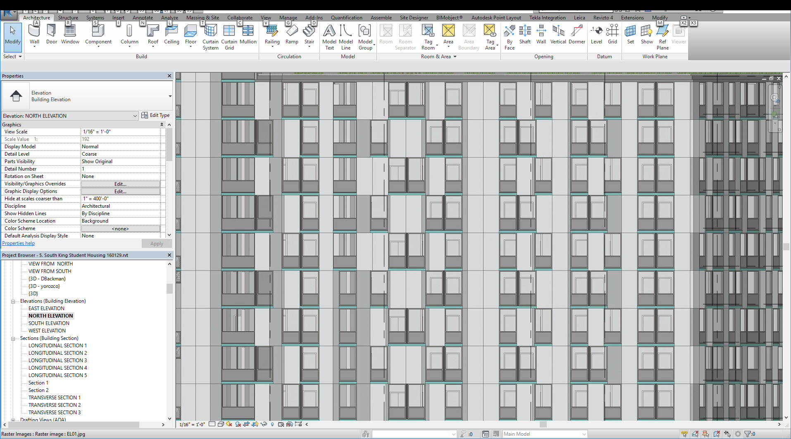

Slide 10
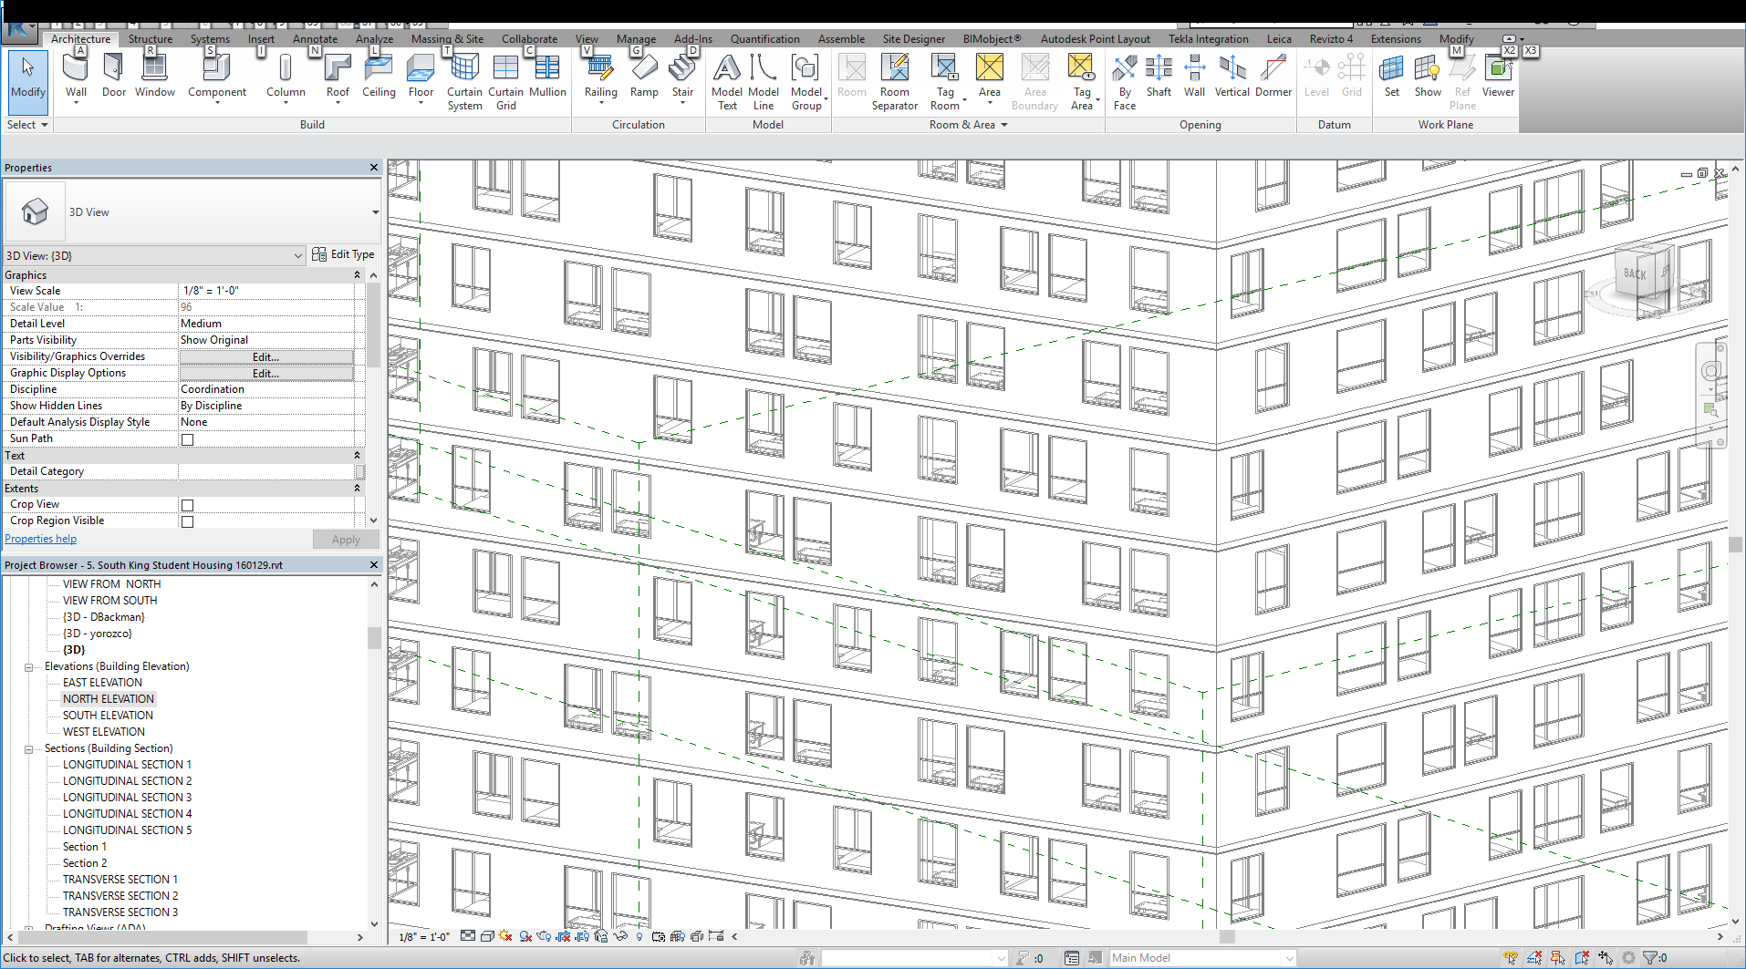

Slide 11
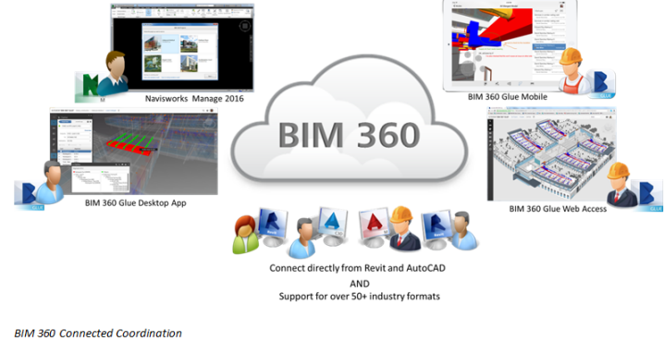

Slide 12
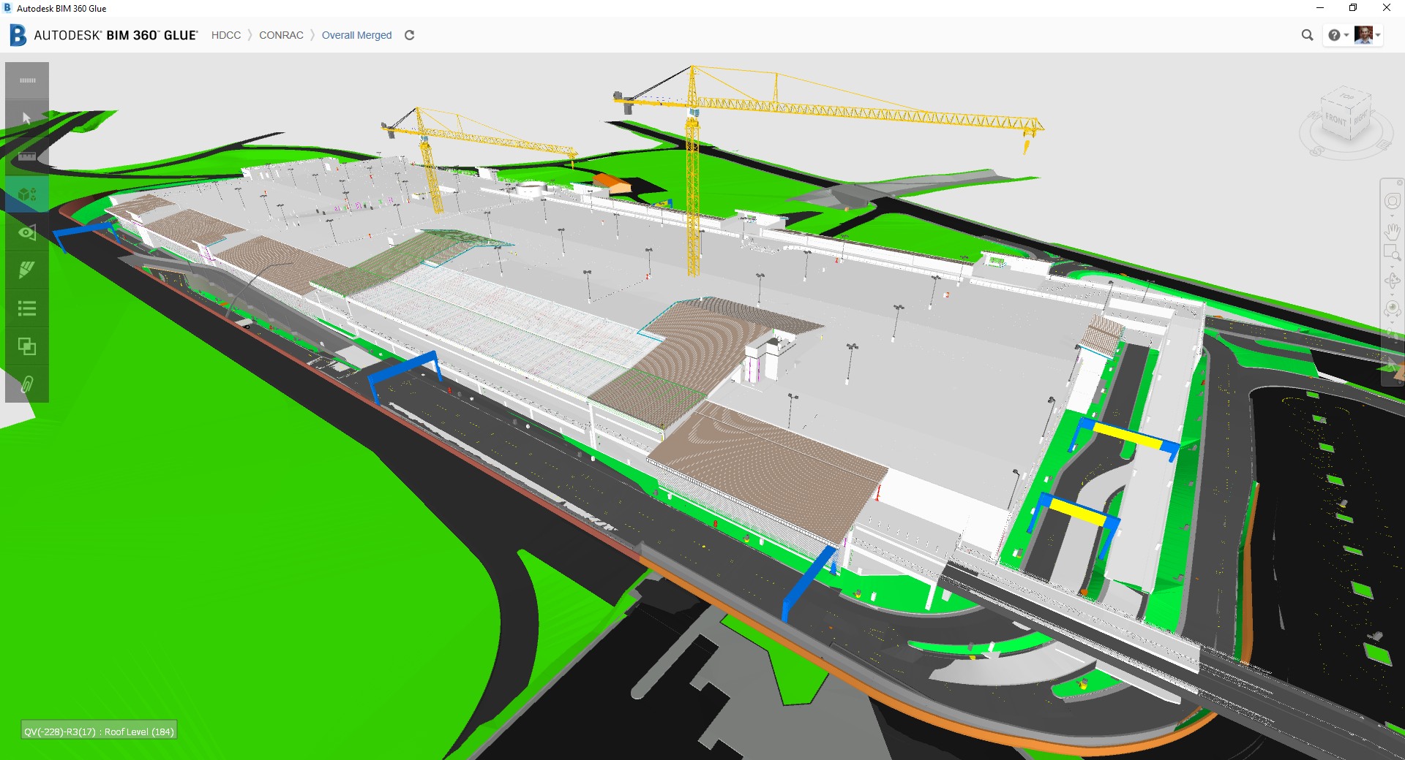

Slide 13
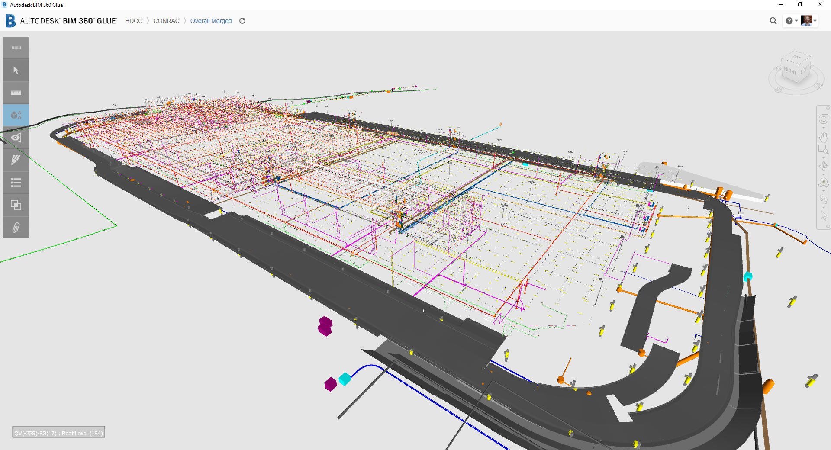

Slide 14
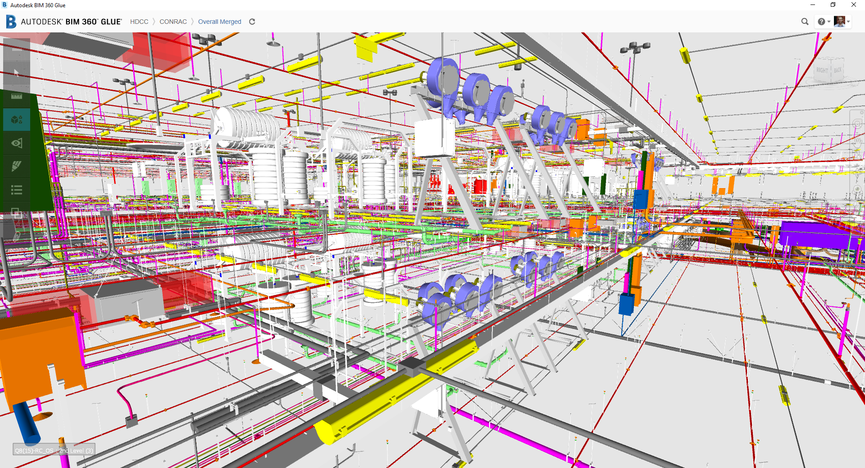

Slide 15

4D Associate Tasks from Schedule to Elements from BIM

Slide 16
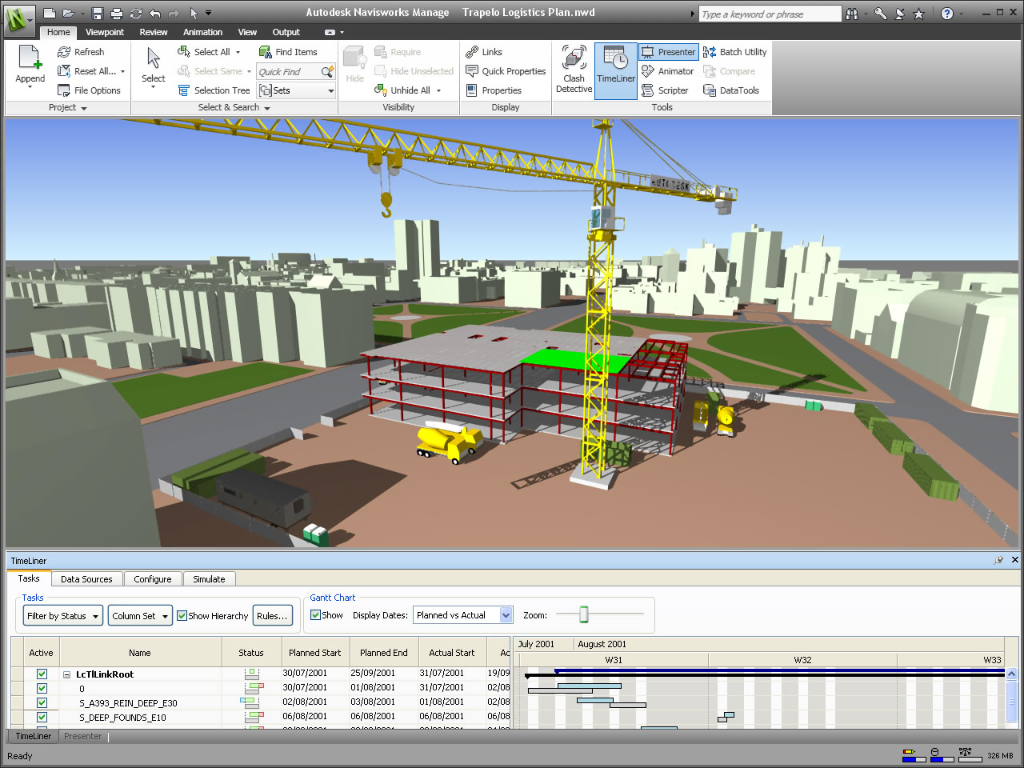
Navisworks Timeliner

Slide 17
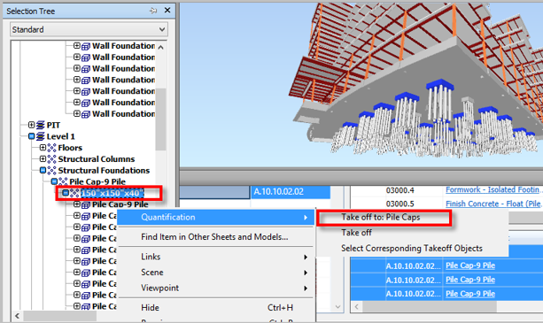
Navisworks – QTO
Length
Width
Thickness
Height
Perimeter
Area
Volume
Weight
Count

Slide 18
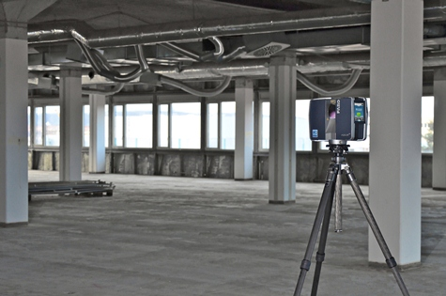
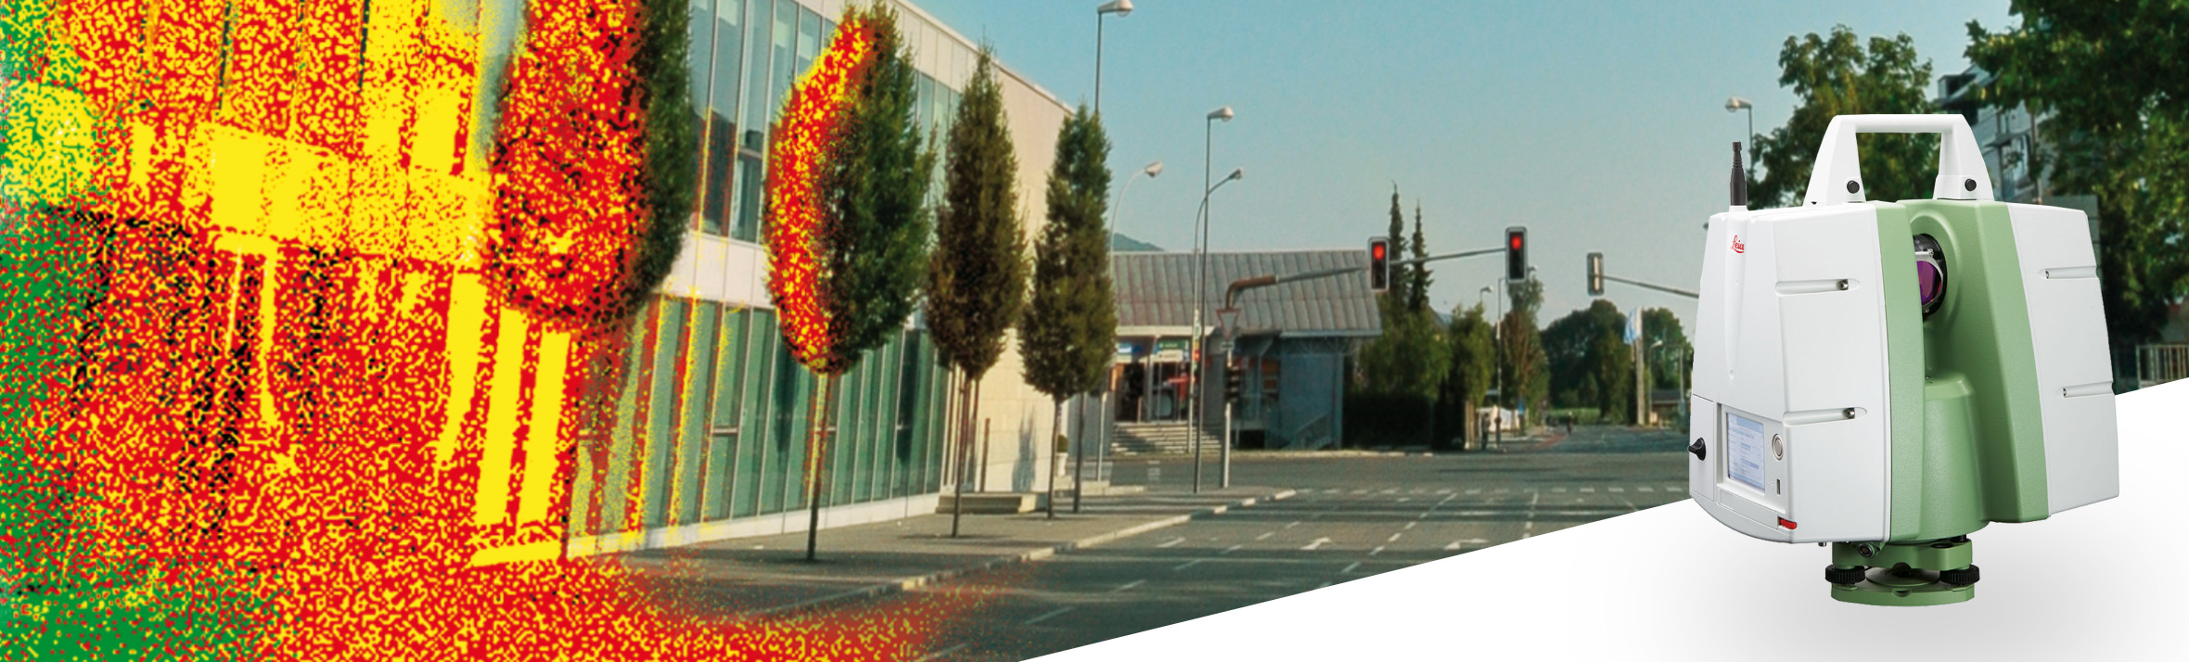

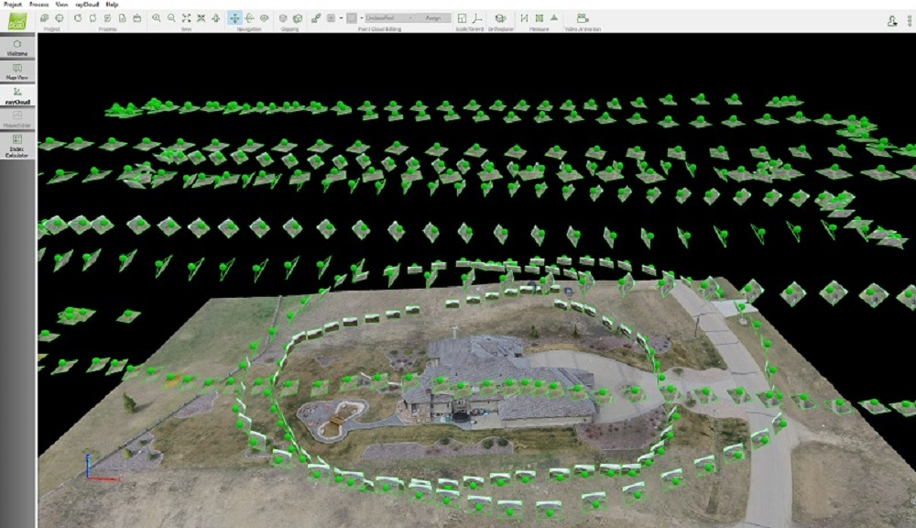
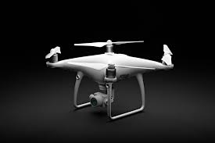
Reality Capture
Active (Laser Scanning)
Passive (Photogrammetry)

Slide 19
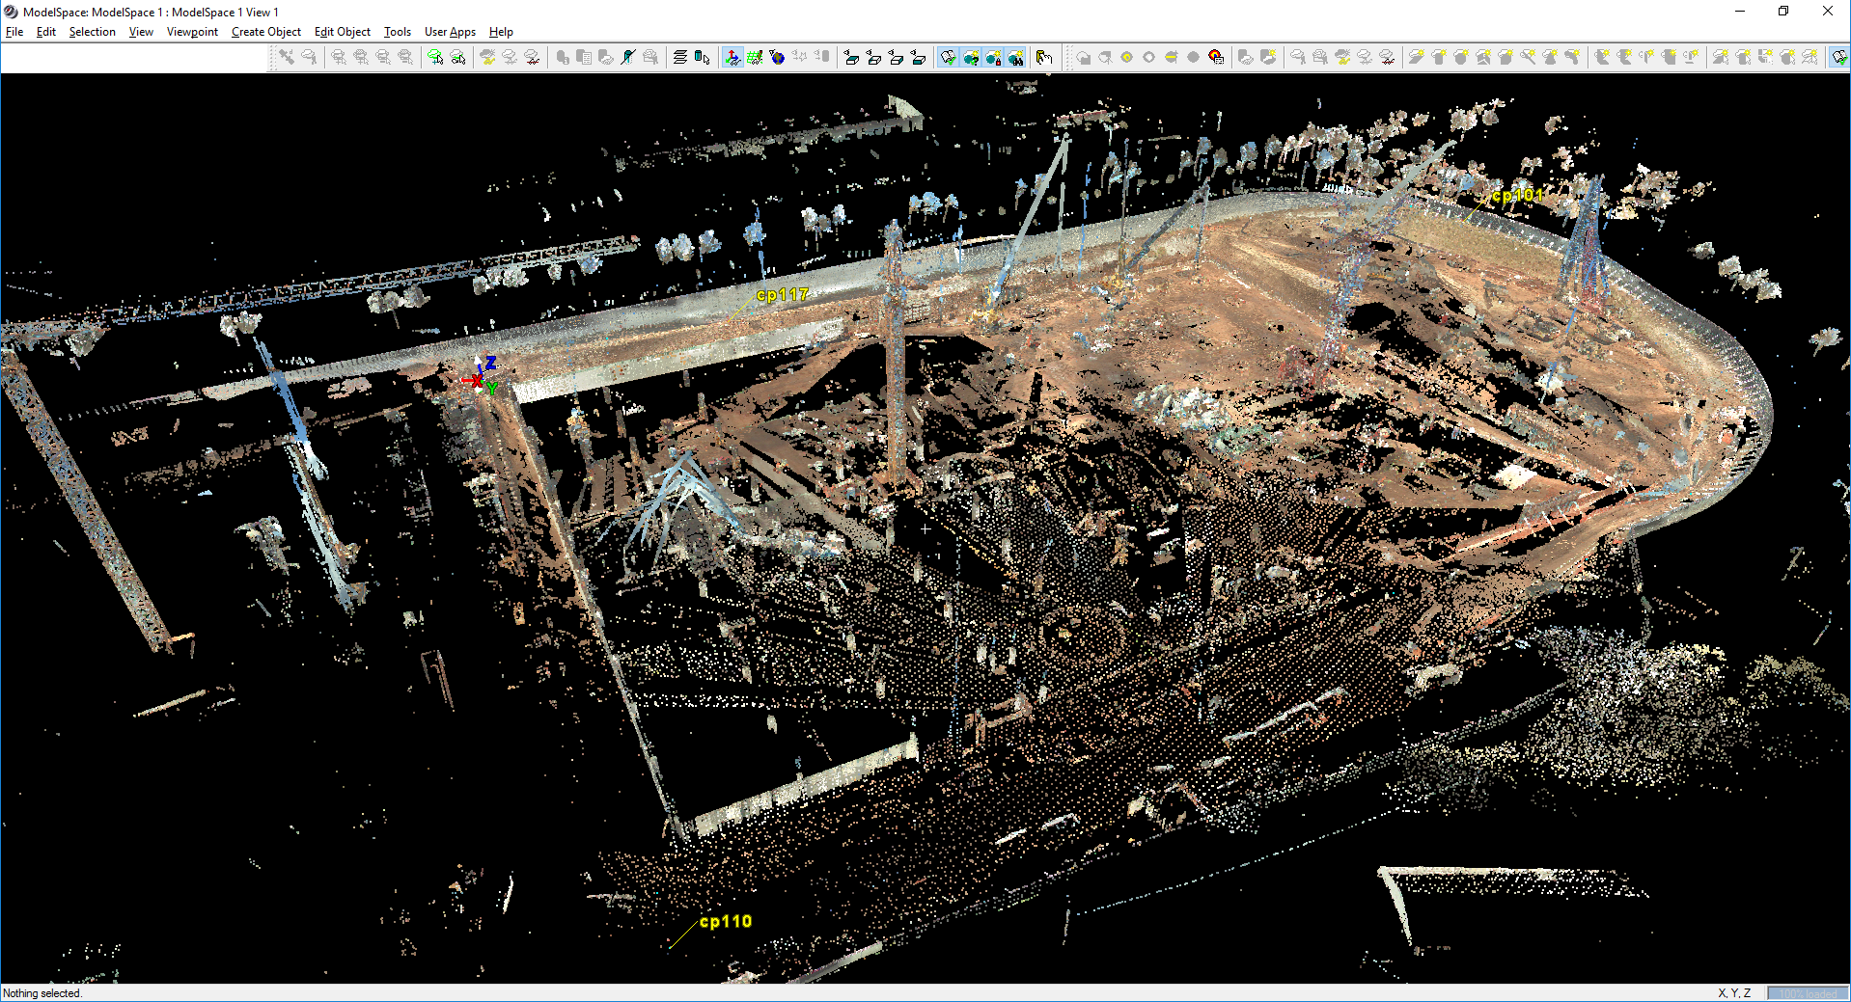

Slide 20
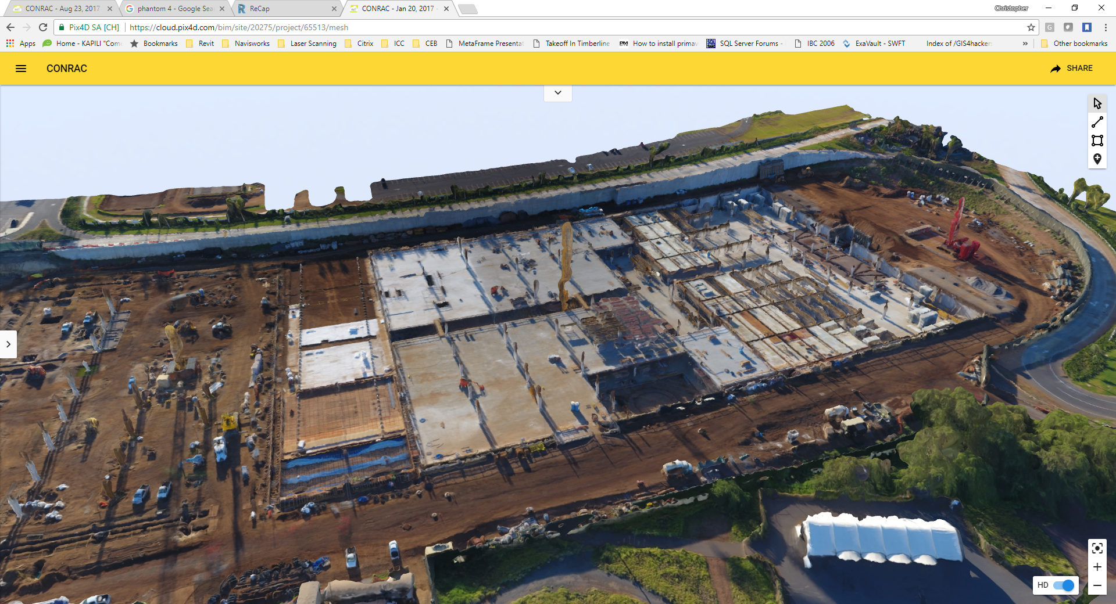

Slide 21
